Slide 1




SHIELD INSURANCE
ANALYSIS
Presented by:
Ritwick Mukherjee

Slide 2


TABLE OF CONTENT
About Company 3
Mockup 4
Home / landing page 5
Key Performence Indicator 6
Overview Analysis 7
Age Group Analysis 8
Sales Mode Analysis 9
Recomendation 10

Slide 3


ABOUT THE COMPANY
Shield Insurance is a leading insurance provider dedicated to offering a wide range of policies tailored to meet the diverse needs of our customers.
With a strong presence in five major Indian cities— Chennai, Delhi, Indore,Hyderabad, and Mumbai.
Shield Insurance ensures that individuals and families across these urban centers have access to reliable and comprehensive insurance coverage
VISION
MISSION

Slide 4
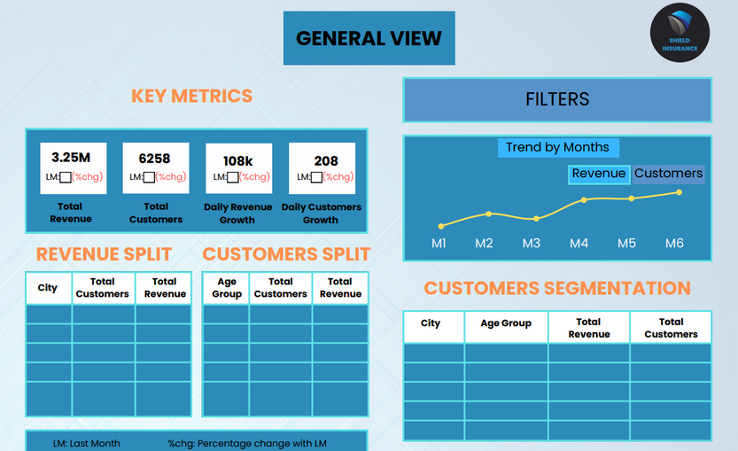
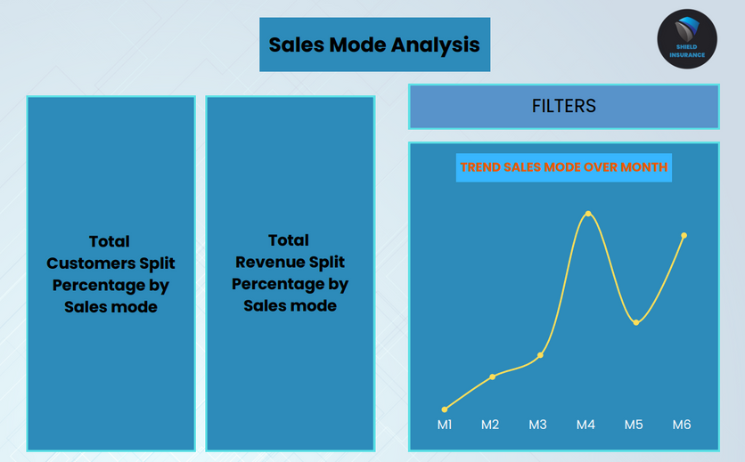

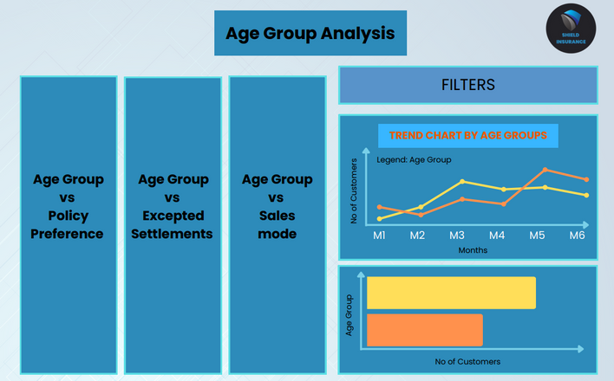
MOCKUP

Slide 5
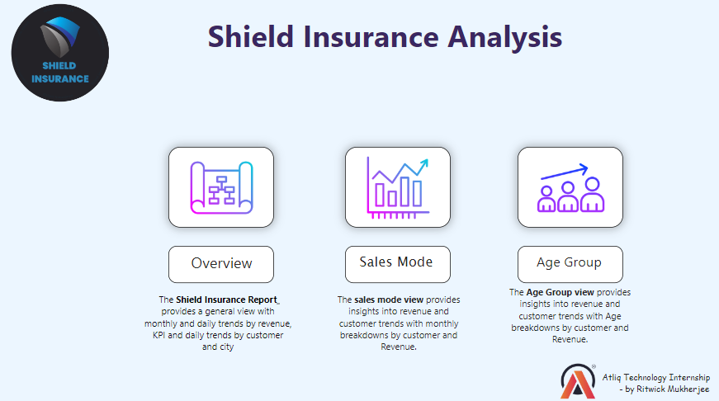



HOME / LANDING PAGE

Slide 6

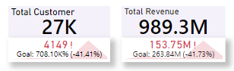
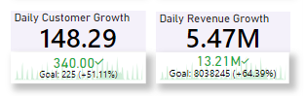
KEY PERFORMANCE INDICATOR
There are 4 key metrics for Shield Insurance: Total Customers, Total Revenue, Daily Customer Growth (DCG), and Daily Revenue Growth (DRG).
Total Customers represent the total number of users of the company, which is around 27K.
Total Revenue is the revenue generated from all policy registrations, amounting to approximately 989M over 6 months.
Daily Customer Growth is the average daily increase in the customer base during a specific month, with an average of 148.29 over the past 6 months.
Daily Revenue Growth is calculated by dividing the total revenue earned in a specific month by the number of unique dates within that month, with a DRG value of 5.47M.
We can also find the previous month values and the percentage change between the previous and selected month
SERVICE 04

Slide 7

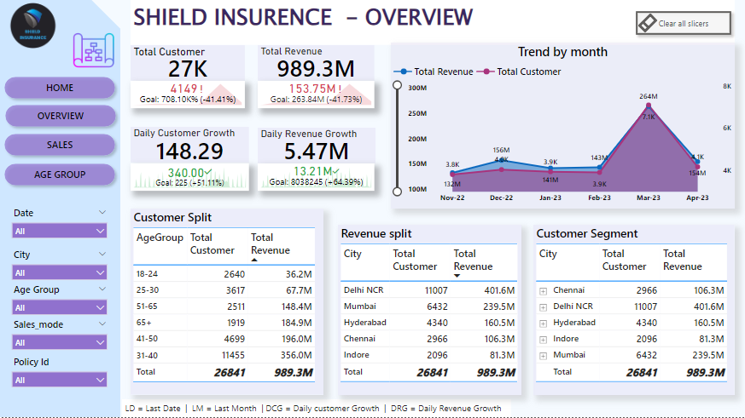
OVERVIEW ANALYSIS
Dive into a bird's-eye perspective of Shield's performance, with key metrics and trends elegantly displayed for quick analysis. From overall revenue trends to customer acquisition metrics, this page serves as the compass guiding strategic decision-making.
The majority of customers are aged between 31 and 40 and are located in the Delhi NCR area. In contrast, the fewest customers are over 65 Indore.
In terms of monthly performance, March 2023 saw the highest number of customers, with 7.1K, and generated a revenue of around 264M. Conversely, November 2022 recorded the lowest number of customers at 3.8K and the lowest revenue of 132M.
Among the policies, POL2005HEL generated the highest revenue, approximately 324M, whereas POL4321HEL generated the lowest revenue, around 25M.

Slide 8

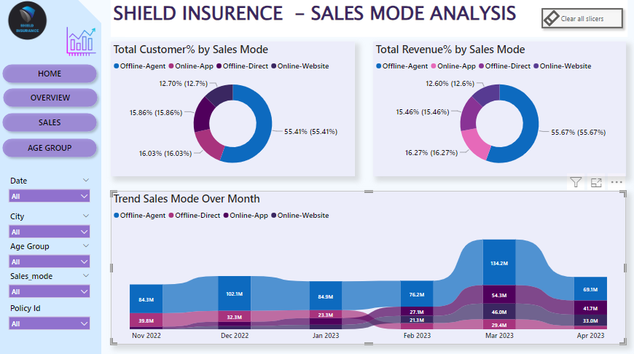
SALES MODE ANALYSIS
Delve deep into the intricacies of sales performance with a dedicated page that dissects sales data based on different modes. Whether it's analyzing the effectiveness of online channels versus traditional avenues or pinpointing the most lucrative sales modes, this page equips the team with insights to optimize sales strategies.
55% of the customers are registered and 551M in revenue is generated by offline agents, and 16% by and 161M offline-direct and online app each.
From November 2022 to April 2023, Offline Agent was the top sales mode. The highest registered customer policy is POL4321HEL. Offline agents consistently led revenue generation, with POL2005HEL generating the most revenue (324M) and POL4321HEL the least (25M). The second-highest revenue sources shifted from offline direct to the online app.
Across all cities, offline agents have generated the highest revenue and regestration. Among the cities, Delhi NCR has the highest registration and revenue at 402M, whereas Indore has the lowest revenue at 81M.

Slide 9
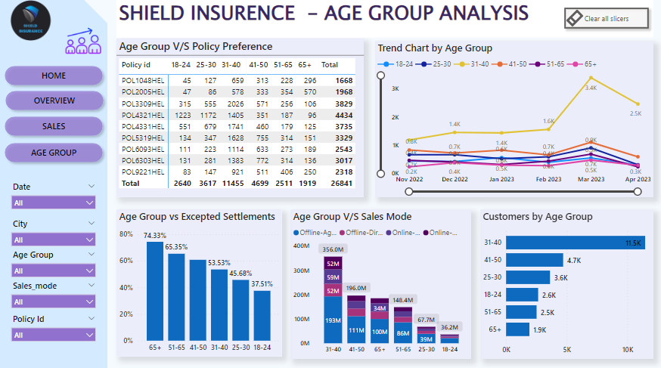
AGE GROUP ANALYSIS
Unveil the power of demographics with a granular exploration of customer age groups. By understanding the preferences and behaviors of different age cohorts, Shield can tailor its offerings and marketing efforts to resonate more deeply with its diverse customer base.
11,209 of the customers are aged around 31- 40, while 1,990 of the customers are aged above 65.
The expected settlement rate for customers above 65 is around 74.33%, and for those aged 50-65, it is 65.35%. The lowest expected settlement rate is for the age group 18-24, which is 37.51%.
POL4321HEL is favored by ages 18-30 and less by 50+. POL2005HEL is preferred by 50+ and less by 18-30, generating 110M from those over 65. POL4321HEL, POL3309HEL, and POL4331HEL earn little from 65+.
Offline agents attracting highest customer across all age groups

Slide 10
RECOMENDATION
Innovative Policies: Introduce new policy types like cyber insurance, pet insurance, and wellness programs.
Customization: Allow policy customization with various coverage options and add-ons.
Expand Agent Network: Recruit more agents in underserved areas to increase reach.
Referral Programs: Offer incentives like discounts or rewards for customer referrals.
Targeted Campaigns: Run marketing campaigns based on demographics, geography, and behavior.
Flexible Payment Plans: Offer flexible payment options like monthly installments

Slide 11


THANK
YOU !!

